Slide 1

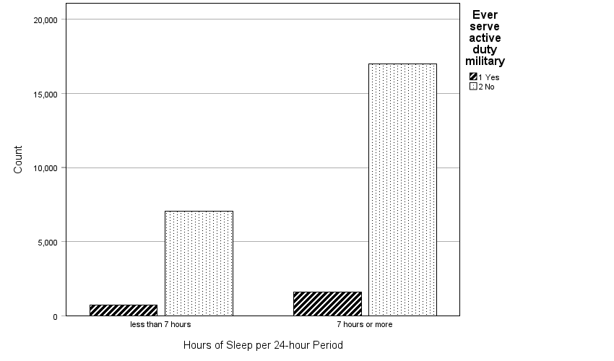
Comparing the proportion of those who have ever served on active-duty who get sufficient sleep to the general U.S. population
Alexander Dorin
Department of Public Health
University of West Florida
Abstract
Purpose: To compare the proportion of sufficient sleep (as defined as ≥ 7 hours of sleep received per 24-hour period) in those who have ever served on active-duty military. Methods: This study utilized data from the 2022 National Health Interview Survey. Analyses were conducted using IBM SPSS Statistics Data Editor software. Results: No statistically significant difference was found between the proportion of sufficient sleep in those who have ever served on active-duty and the general U.S. population. Conclusion: Active-duty military personnel face many unique challenges that decrease their ability to achieve sufficient sleep; however, future research is needed to compare the proportion of sufficient sleep in those currently active-duty and those who have separated from service to better understand the difference between the two populations.
introduction
Active-duty U.S. military personnel represent a unique population and are exposed to unique situations. Sleep deprivation, sleep efficiency, performance maintenance, circadian rhythm disturbances, and mission-related maladaptive sleep practices are but a few sleep-related subjects that have been studied in the military population (Office of Under Secretary of Defense, 2021). Of specific interest to this research study, the Department of Defense Health-Related Behavior Survey, conducted between 2005–2018, revealed that approximately 64% of active-duty personnel sleep less than seven hours per twenty-four-hour period (Meadows et al., 2021). This study also revealed that 56% of active-duty service personnel achieved less sleep than needed to perform their specific job-related duties well. This is in comparison to the most recent data from U.S. Department of Health and Huma Services (2020) that revealed 69.9% of U.S. adults aged 18 years and older receive sufficient sleep which is defined as at least seven hours per twenty-four-hour period.
Compared to firefighters (46%), law enforcement officers (40%), and healthcare professionals (40%), active-duty military personnel (55-76%) have a much larger proportion of those who suffer from partial sleep deprivation, defined as approximately seven hours or less of sleep per night (Shockey & Wheaton, 2017).
The U.S. Army Health of the Force Report in 2020 found that productivity decreased by 10-15% in Soldiers who slept less than six hours per night (Hauschild, 2023).
methodology
This study utilized a sample of 26,359 adults 18 years or older from the 2022 National Health Interview Survey. The independent variable was those who have ever served on active-duty. The dependent variable was the number of hours of sleep that the participant received in a 24-hour period.
The study utilized a cross-sectional data source (NHIS), the dependent variable was categorical, and the independent variable was dichotomous. The Chi-square Test of Independence was used to test for association and determine if the two different populations are statistically different from each other with regard to the dependent variable. The minimum significance level was set at p < 0.05, two-tailed. The analyses were conducted using IBM SPSS Statistics Data Editor software.
results
In the ever served active-duty military population (n = 2,355), the mean hours of sleep received per 24-hour period was 7.14 (M = 7.14, SD = 1.59). In the general U.S. population (n = 24,004), the mean hours of sleep received per 24-hour period was 7.13 (M = 7.13, SD = 1.382).
A Chi-Square Test of Independence was performed to analyze the two target populations’ sleep data under the codes of 0 (< 7 hours of sleep received per 24-hour period) and 1 (≥ 7 hours of sleep received per 24-hour period). No statistically significant difference was found between the proportion of sufficient sleep (≥ 7 hours of sleep received per 24-hour period) in those who have ever served on active-duty military to the general U.S. population, χ² (1, N = 26,359) = 2.963, p = .085. The expected counts for all cells were well above 5, meeting the minimum expected count assumption for conducting the Chi-Square Test with validity.
Discussion
The results of this study contradict previous studies which have shown a statistically significant difference between active-duty personnel and non-active-duty personnel, and the proportion of those who receive sufficient sleep between the two populations (Meadows et al., 2021). The results from this study show that those who have ever served on active-duty, including those who are now veterans, receive approximately the same amount of sleep per 24-hour period and have approximately the same proportion of those who receive sufficient sleep, as those of the general U.S. population (mean of each population was 7.14 hours vs 7.13 hours, respectively).
This conflicting evidence could be secondary to limitations of this study, including the fact that previous studies have examined solely active-duty personnel, whereas this study utilized raw data from the 2022 National Health Interview Survey to conduct analyses on those who have ever or never served on active-duty. A significant limitation is that the ‘ever served as active-duty military’ population may include those who are currently active-duty in addition to those who have served on active-duty in the past but are now civilians. The distinction between the two subset populations of the ‘ever served as active-duty military’ group is that active-duty personnel face many military-specific situations such as deployments, detachments, circadian rhythm disruptions, and uniquely high-stress environments (Good et al., 2019). These environmental and situational stressors are known to cause disruptions in sleep and most of these active-duty military-specific stressors are likely to cease to exist after a veteran has separated from active-duty service (Shockey & Wheaton, 2017).
It is possible that a considerable proportion of veterans have improvements in their sleep after separating from active-duty service, including those who may suffer from comorbidities such as insomnia, obstructive sleep apnea, movement disorders, anxiety, depression, PTSD, or chronic pain.
Future research that incorporates demographic variables such as gender, race, age, and sex would also add valuable information.
.
conclusions
The purpose of this study was to compare the proportion of sufficient sleep (as defined as ≥ 7 hours of sleep received per 24-hour period) in those who have ever served on active-duty military to the general U.S. population. Although no statistically significant difference was found, the results help emphasize how active-duty personnel represent a unique population with unique, military-specific stressors that act as barriers to achieving sufficient sleep.
Research aiming at better understanding the etiology of insufficient sleep in active-duty personnel and how to increase the proportion of sufficient sleep is needed. The goals of this study and recommended future studies are in alignment of one of the Healthy People 2030 goals of increasing the proportion of those who receive sufficient sleep in the U.S. population. Improving the proportion of those who receive sufficient sleep in active-duty personnel could lead to an increase in performance, decrease mishaps, decrease comorbidities, and increase lifespans.
REFERENCES
Good, C. H., Brager, A. J., Capaldi, V. F., & Mysliwiec, V. (2019). Sleep in the United States Military. Neuropsychopharmacology, 45(1), 176–191. https://doi.org/10.1038/s41386-019-0431-7
Hauschild, V. (2023, March 15). Military recognizes importance of sleep, investigates use of alternative treatment device for sleep apnea. U.S. Army. https://www.army.mil/article/264859/military_recognizes_importance_of_sleep_investigates_use_of_alternative_treatment_device_for_sleep_apnea
Meadows, S. O., Engel, C. C., Collins, R. L., Beckman, R. L., Breslau, J., Bloom, E. L., Dunbar, M. S., Gilbert, M., Grant, D., Hawes-Dawson, J., Holliday, S. B., MacCarthy, S., Pedersen, E. R., Robbins, M. W., Rose, A. J., Ryan, J., Schell, T. L., & Simmons, M. M. (2021, April 28). 2018 Department of Defense health related behaviors survey (HRBS): Results for the active component. RAND. https://www.rand.org/pubs/research_reports/RR4222.html
Shockey, T. M., & Wheaton, A. G. (2017). Short sleep duration by occupation group — 29 states, 2013–2014. Morbidity and Mortality Weekly Report, 66(8), 207–213. https://doi.org/10.15585/mmwr.mm6608a2
U.S. Department of Health and Human Services. (2020). Sleep. https://health.gov/healthypeople/objectives-and-data/browse-objectives/sleep
Photo
aim
The purpose of this study was to compare the proportion of sufficient sleep (as defined as ≥ 7 hours of sleep received per 24-hour period) in those who have ever served on active-duty military to the general U.S. populaion.
Figure 1. Frequencies of both groups (ever served active-duty military vs never-served active-duty military) displayed by hours of sleep per 24-hour period, as two separate categories (< 7 hours of sleep received per 24-hour period and ≥ 7 hours of sleep received per 24-hour period).

