Slide 1
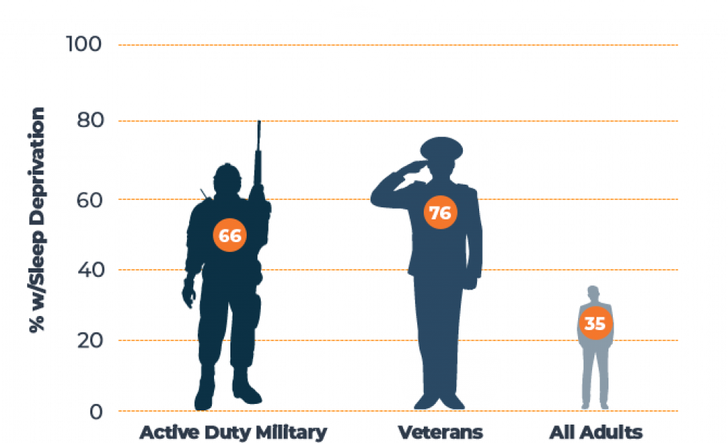
Naval Hospital Jacksonville strives to increase sleep quality and effectively treat sleep disorders in our active-duty personnel. | Naval Hospital Jacksonville 2080 Child St. Jacksonville, Florida 32214 (904) 542-7300 | Improving Sleep in Active-duty Personnel

Slide 2
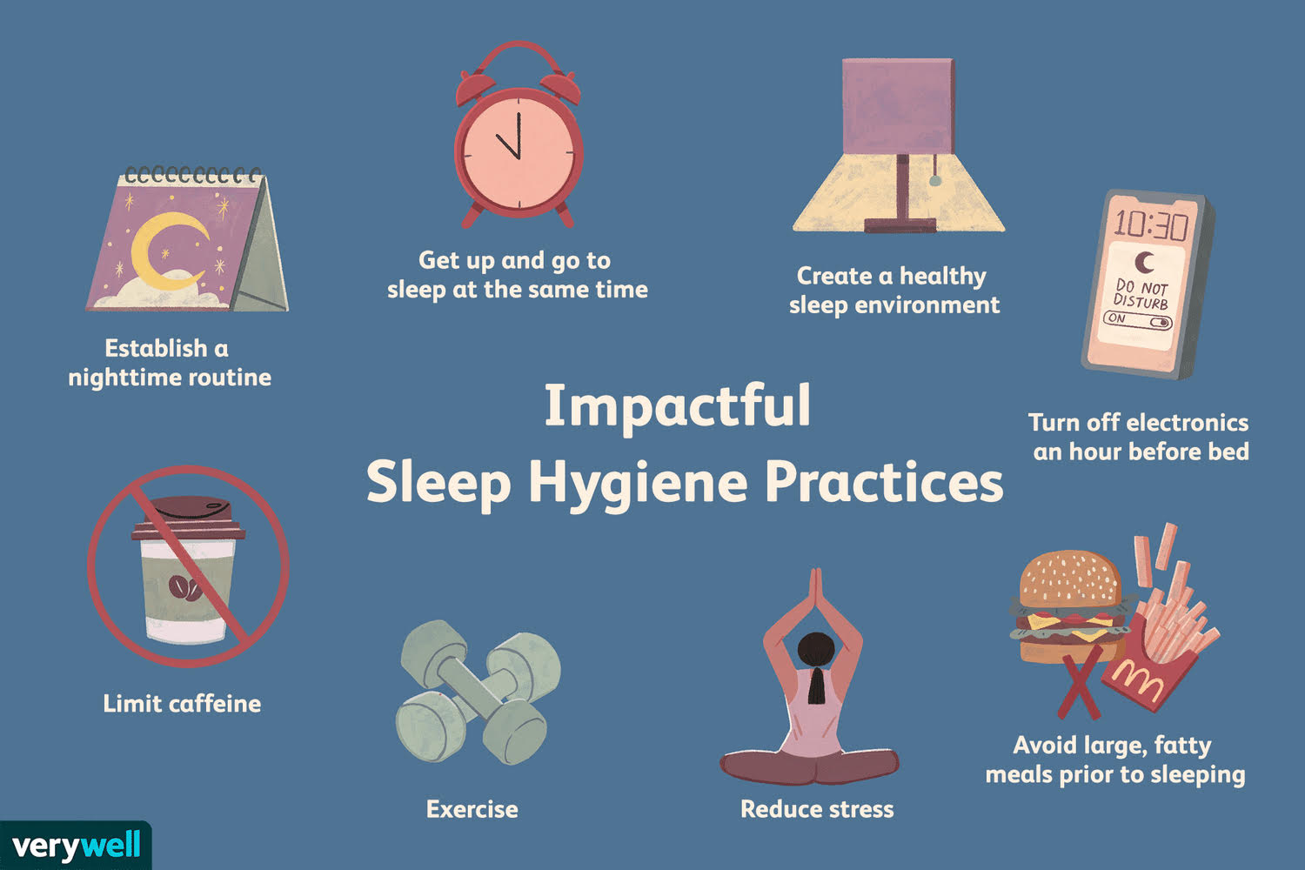
Keep noise to a minimum
Lower bedroom temperatURE
No electronic before bed
Exercise during the day
Avoid caffeine after 2 p.m.
Avoid alcohol intake
Avoid nicotine intake
PRACTICE meditation, yoga, or Tai Chi
The problem ~1/3 Americans do not get sufficient sleep (defined as ≥ 7 hours per 24-hour period) Studies report 62 – 74% of military personnel do not receive sufficient sleep Poor sleep can cause decreased performance, cardiovascular disease, anxiety, depression and more Why is this happening? Deployments Sleep deprivation Circadian rhythm disorders Nightmares/night terrors Traumatic brain injuries Pain PTSD Obstructive sleep apnea Insomnia Anxiety and depression | The solution Identify if you have a problem with sleep See your provider to screen to get screened for sleep disorders Practice sleep hygiene Ask about cognitive behavioral therapy – insomnia Treat underlying anxiety, depression, and PTSD Sleep Hygiene | Cognitive Behavioral Therapy - Insomnia
Gold-standard treatment for insomnia
Focuses on restructuring thoughts and behaviors that contribute to insomnia
Effective for acute and chronic insomnia
Can be self-guided (websites, apps, online coaches) or completed by a behavioral health specialist (in-person or virtually)

