Slide 1
Comparing the Proportion of Those Who Have Ever Served on Active-duty Who Get Sufficient Sleep to the General U.S. Population
Alexander Dorin, DO
Preceptor: Dr. Jami Buckley, MD, MPH
Faculty Advisor: Dr. Tshiswaka
Naval Hospital Jacksonville

Slide 2
Disclosures
Alexander Dorin has no financial disclosures that would be a conflict of interest with this presentation.

Slide 3
Outline
Alignment between select MPH competency, Healthy People 2030 Objective, and variable of interest
Background
Public Health Significance
Methodology
Results
Discussion/Conclusions
Limitations
Lessons Learned
ePortfolio link

Slide 4
Alignment between HP2030, MPH competency, and variable of interest
Foundational competency: C-1. Apply epidemiological methods to the breadth of settings and situations in public health practice
Healthy People 2030 Objective: increase the proportion of adults who get sufficient sleep
Variable of interest: personnel who have ever served on active-duty

Slide 5
Healthy People 2030 Objective
Increase the proportion of adults who get enough sleep
Goal: 73.3% by 2030
2020: 72.3%
2022: 69.9%

Slide 6
Background
Active-duty U.S. military personnel are unique
DoD Health-Related Behavior Survey: 64% sleep < 7 hours per 24-hour period (Meadows et al., 2021)
2017 study: 55-67% sleep < 7 hours per 24-hour period (Shockey & Wheaton)

Slide 7
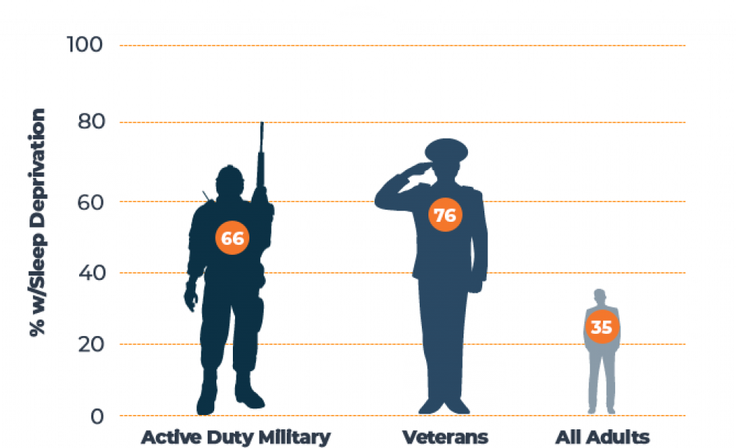
Background
Mattei, 2020

Slide 8
Background
2019 study: 86% of U.S. Army personnel deployed to Afghanistan receive < 7 hours (Good et al.)
Military-specific stressors
Deployments
Sleep deprivation
Circadian rhythm disorders
TBIs, PTSD, chronic pain, OSA, insomnia, anxiety, depression

Slide 9
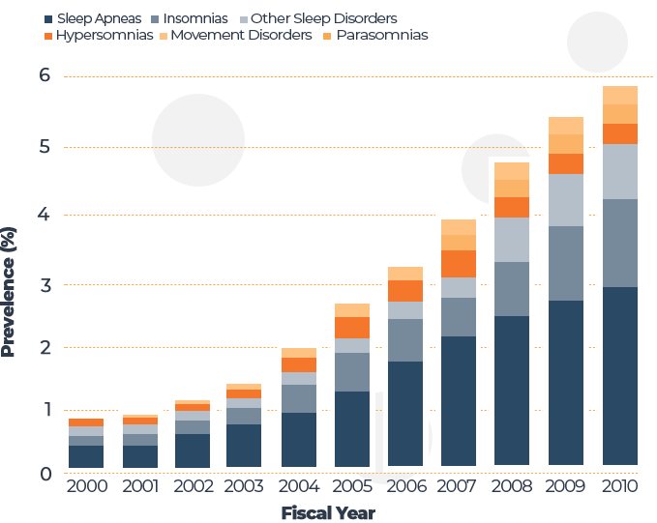
Background
Mattei, 2020

Slide 10
Public Health Significance
Identify the proportion of those who have ever served on active-duty that get sufficient sleep
Establish an accurate baseline and set a benchmark for improvement
Improvements in sleep can lead to increased performance and decreased mishaps

Slide 11
Methodology
26,359 adults from the 2022 National Health Interview Survey (NHIS)
Outcome variable: number of hours of sleep per 24-hour period
Independent variable:
Those who have ever served on active-duty

Slide 12
Methodology
Chi-square Test of Independence
Minimum significance level: p < 0.05, two-tailed
IBM SPSS Statistics Data Editor Software
Codes:
0 = < 7 hours of sleep received per 24-hour period
1 = ≥ 7 hours of sleep received per 24-hour period

Slide 13
Results
Ever served active-duty:
n = 2,355, M = 7.14, SD = 1.59
General U.S. population:
n = 24,004, M = 7.13, SD = 1.38
Table 1 Ever served active-duty military
 |  | Frequency | Percent
Valid | Yes | 2355 | 8.9
 | No | 24004 | 91.1
 | Total | 26359 | 100.0

Slide 14
Results
No statistically significant difference was found between the proportion of sufficient sleep between the two populations, χ² (1, N = 26,359) = 2.963, p = .085
Proportions:
Ever served active-duty = 0.697 (69.7%)
General U.S. population = 0.701 (70.1%)

Slide 15
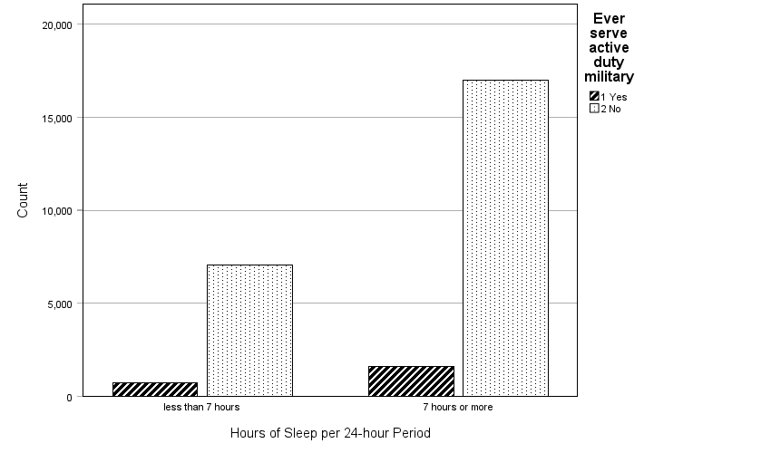
Results
Figure 1. Frequencies of both groups (ever served active-duty military vs general U.S. population) displayed by hours of sleep per 24-hour period, as two separate categories (< 7 hours of sleep received per 24-hour period and ≥ 7 hours of sleep received per 24-hour period).

Slide 16
Results
Table 4 SLPHOURS_A * Ever served active-duty military Crosstabulation
 |  |  | Ever served active-duty military |  | Total
 |  |  | Yes | No
SLPHOURS_A | less than 7 hours | Count | 730 | 7034 | 7764
 |  | % of Total | 2.8% | 26.7% | 29.5%
 | 7 hours or more | Count | 1625 | 16970 | 18595
 |  | % of Total | 6.2% | 64.4% | 70.5%
Total |  | Count | 2355 | 24004 | 26359
 |  | % of Total | 8.9% | 91.1% | 100.0%

Slide 17
Results
Table 5 Chi-Square Tests
 | Value | df | Asymptotic Significance (2-sided) | Exact Sig. (2-sided) | Exact Sig. (1-sided)
Pearson Chi-Square | 2.963ª | 1 | .085
Continuity Correction^{b} | 2.882 | 1 | .090
Likelihood Ratio | 2.937 | 1 | .087
Fisher's Exact Test |  |  |  | .088 | .045
Linear-by-Linear Association | 2.963 | 1 | .085
N of Valid Cases | 26359
a. 0 cells (0.0%) have expected count less than 5. The minimum expected count is 693.66.
b. Computed only for a 2x2 table

Slide 18
Discussion/Conclusions
Results of this study contradict previous studies which have shown a significant difference between active-duty personnel and non-active-duty personnel
No statistically significant difference
Mean of each population was nearly identical (7.14 hours vs 7.13 hours)

Slide 19
Discussion/Conclusions
Results help emphasize how active-duty personnel represent a unique population with unique, military-specific stressors that act as barriers to achieving sufficient sleep
Improving sleep in active-duty personnel could lead to an increase in performance, decrease mishaps, decrease comorbidities, and increase lifespans

Slide 20
Limitations
Ever served active-duty population includes:
Active-duty personnel
Veterans (those who have separated from service)
Veterans likely no longer face military-specific stressors
Deployments, detachments, circadian rhythm disruptions, high-stress environments and situations

Slide 21
Public Health Lessons Learned
Goal of identifying the proportion of those who have ever served on active-duty that get sufficient sleep was met
Identified an area of research that deserves further investigation and intervention
Educational brochure was created; a lecture was given in aims of improving the proportion of active-duty personnel who achieve sufficient sleep

Slide 22
Recommendations
Research aimed at comparing sleep in those who are currently active-duty to sleep in those who have separated from service is needed
Research aimed at better understanding the etiology of insufficient sleep in active-duty personnel and how to increase the proportion of sufficient sleep is needed

Slide 23
ePortfolio Link
https://www.docalexdorindo.com/

Slide 24
Acknowledgements
Dr. Buckley
Dr. Tshiswaka
Ms. Reichardt

Slide 25
References
Centers for Disease Control and Prevention. (2022, February 8). NHIS - 2022 NHIS. https://www.cdc.gov/nchs/nhis/2022nhis.htm
Good, C. H., Brager, A. J., Capaldi, V. F., & Mysliwiec, V. (2019). Sleep in the United States Military. Neuropsychopharmacology, 45(1), 176–191. https://doi.org/10.1038/s41386-019-0431-7
Mattei, M. (2020, January 10). Sleep Deprivation in the Military: Resources for Seeking Help. The Sleep Advisor. https://www.sleepadvisor.org/military-and-veteran-sleep/

Slide 26
References
Meadows, S. O., Engel, C. C., Collins, R. L., Beckman, R. L., Breslau, J., Bloom, E. L., Dunbar, M. S., Gilbert, M., Grant, D., Hawes-Dawson, J., Holliday, S. B., MacCarthy, S., Pedersen, E. R., Robbins, M. W., Rose, A. J., Ryan, J., Schell, T. L., & Simmons, M. M. (2021, April 28). 2018 Department of Defense health related behaviors survey (HRBS): Results for the active component. RAND. https://www.rand.org/pubs/research_reports/RR4222.html
Shockey, T. M., & Wheaton, A. G. (2017). Short sleep duration by occupation group — 29 states, 2013–2014. Morbidity and Mortality Weekly Report, 66(8), 207–213. https://doi.org/10.15585/mmwr.mm6608a2

