Slide 1
Improving Sleep in Active-duty Personnel
Alex Dorin
Preceptor: Dr. Jami Buckley, MD, MPH
University of West Florida
Spring 2024

Slide 2
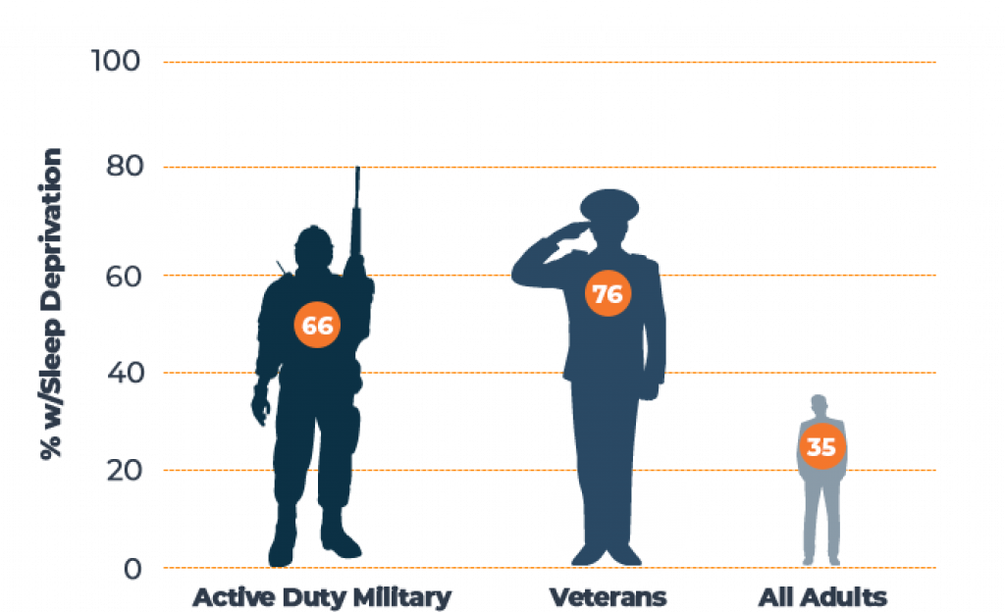
The Problem
~1/3 Americans do not get sufficient sleep (defined as ≥ 7 hours per 24-hour period)
Studies report 62 – 74% of military personnel do not receive sufficient sleep
Poor sleep can cause decreased performance, cardiovascular disease, anxiety, depression and more

Slide 3
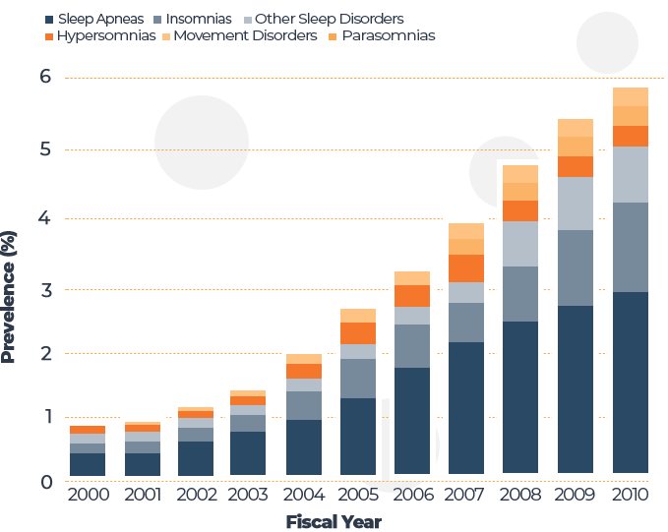
Why is this happening?
Deployments
Sleep deprivation
Circadian rhythm disorders
Nightmares/night terrors
Traumatic brain injuries
Pain
PTSD
Obstructive sleep apnea
Insomnia
Anxiety and depression

Slide 4
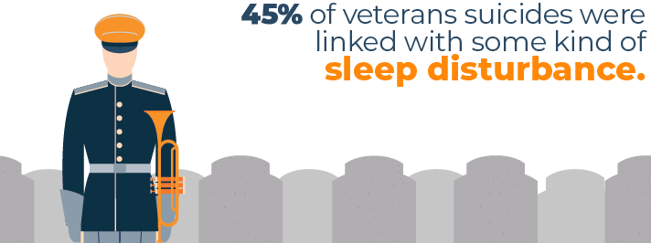
Insomnia and PTSD are linked to suicidal ideations

Slide 5
What Can We Do?
Ask the question: “Are you having difficulty sleeping?”
Screen for common conditions when clinically appropriate
Teach sleep hygiene
Offer cognitive behavioral therapy - insomnia
Treat underlying anxiety, depression, and PTSD

Slide 6
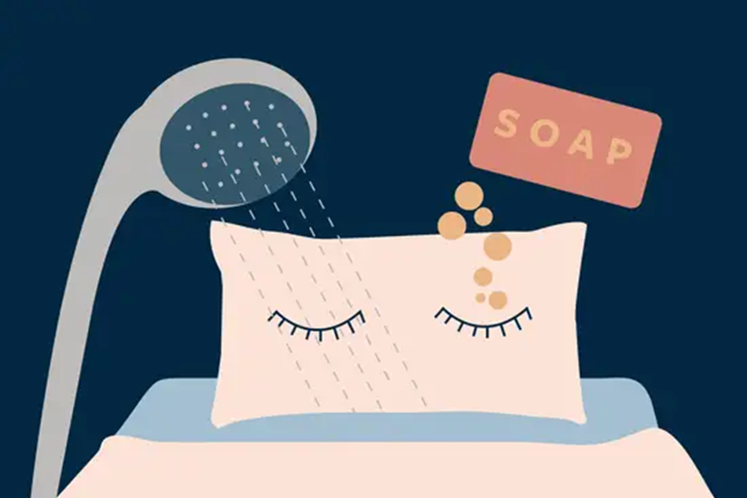
Sleep Hygiene Education for Patients

Slide 7
Sleep Hygiene
Keep a consistent sleep schedule
Promote a relaxing sleep environment
Use your bed ONLY for sleeping (no tv, eating, scrolling on phone, etc.)
If you cannot fall asleep after 20 minutes, get up and do something relaxing, such as reading in dimmed light, or a light walk
Limit excessive light exposure in the hours prior to bedtime

Slide 8
Sleep Hygiene
Keep noise to a minimum
Lower bedroom temperature to 65 - 68 degrees F
No electronics for the hour prior to bedtime
Exercise during the day
Avoid caffeine after 2 p.m.
Avoid alcohol intake
Avoid nicotine intake
Consider meditation, yoga, or Tai Chi

Slide 9
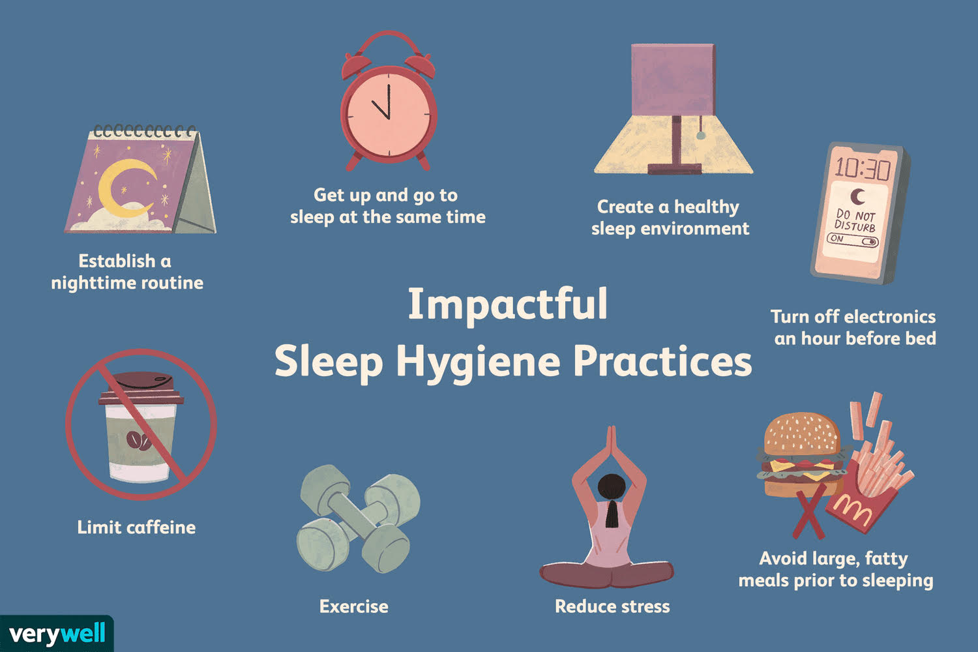

Slide 10
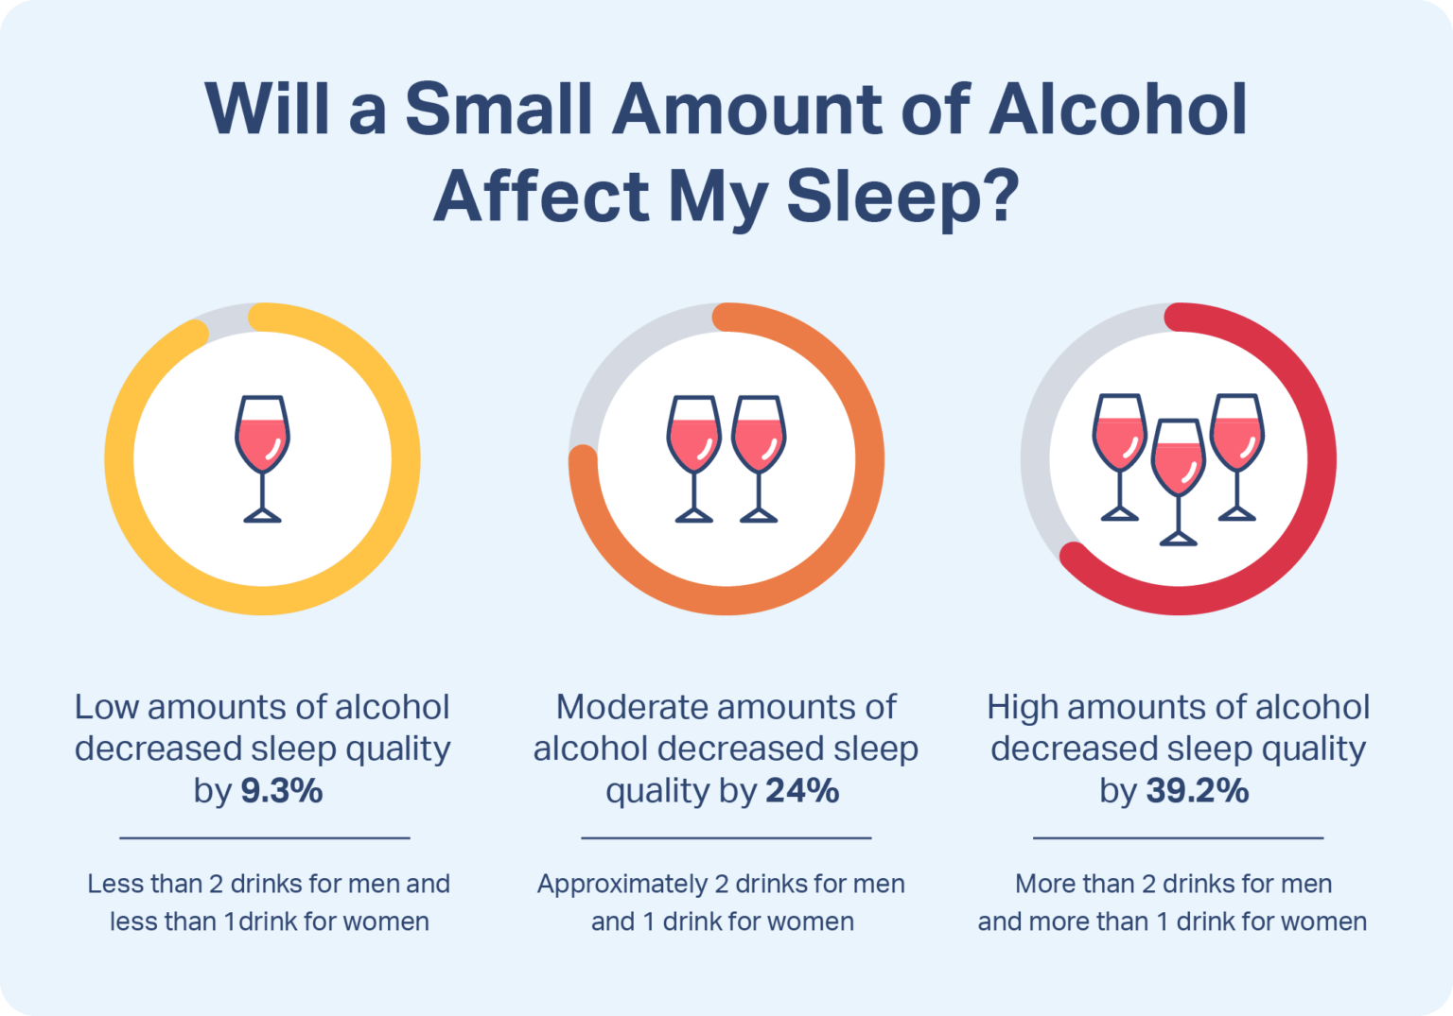

Slide 11
Cognitive Behavioral Therapy - Insomnia
Gold-standard treatment for insomnia
Focuses on restructuring thoughts and behaviors that contribute to insomnia
Effective for acute and chronic insomnia
Can be self-guided (websites, apps, online coaches) or completed by a behavioral health specialist (in-person or virtually)

Slide 12
Benefits of Sleep Meditation
Decreased fight or flight response
Creates physical and mental relaxation
Can decrease pain
Increased mindfulness
Can decrease anxiety, depression, and insomnia

Slide 13
How to Practice Sleep Meditation
Quiet environment
Comfortable position
Deep breathing
Boxed breathing (4 second inhale, 4 second hold, 4 second exhale, 4 second hold)
Body scanning
Yoga
Tai Chi

Slide 14
Summary
Active-duty personnel have increased risk factors for insomnia and other sleep disorders
Important to ask the question: “Are you having difficulty sleeping?”
Treat underlying disorders
Teach sleep hygiene
Offer cognitive behavioral therapy – insomnia

Slide 15
References
Mattei, M. (2020, January 10). Sleep Deprivation in the Military: Resources for Seeking Help. The Sleep Advisor. https://www.sleepadvisor.org/military-and-veteran-sleep/
Newsom, R. (2020). Cognitive behavioral therapy for insomnia (CBT-I). Sleep Foundation. https://www.sleepfoundation.org/insomnia/treatment/cognitive-behavioral-therapy-insomnia
Ryan, T. (2021, May 26). The Military and Sleep. Sleep Foundation. https://www.sleepfoundation.org/sleep-in-the-military
Stanley, N. (2021, March 11). The origin of sleep hygiene. Www.sleepstation.org.uk. https://www.sleepstation.org.uk/articles/sleep-basics/sleep-hygiene/
Summer, J. (2022, December 16). Meditation and Sleep. Sleep Foundation. https://www.sleepfoundation.org/meditation-for-sleep
Suni, E., & Singh, A. (2020, July 30). How to sleep better. Sleep Foundation. https://www.sleepfoundation.org/sleep-hygiene/healthy-sleep-tips

Slide 16
Image References
Lindberg, S. (2023, January 17). What Is Sleep Hygiene? Verywell Mind. https://www.verywellmind.com/what-is-sleep-hygiene-5085887
Mattei, M. (2020, January 10). Sleep Deprivation in the Military: Resources for Seeking Help. The Sleep Advisor. https://www.sleepadvisor.org/military-and-veteran-sleep/
Stanley, N. (2021, March 11). The origin of sleep hygiene. Www.sleepstation.org.uk. https://www.sleepstation.org.uk/articles/sleep-basics/sleep-hygiene/
Suni, E., & Singh, A. (2020, July 30). How to sleep better. Sleep Foundation. https://www.sleepfoundation.org/sleep-hygiene/healthy-sleep-tips

